Slide 1
Action-Conditioned Object Grounding for Video Description Generation
Luowei Zhou
12/02/2018

Slide 2
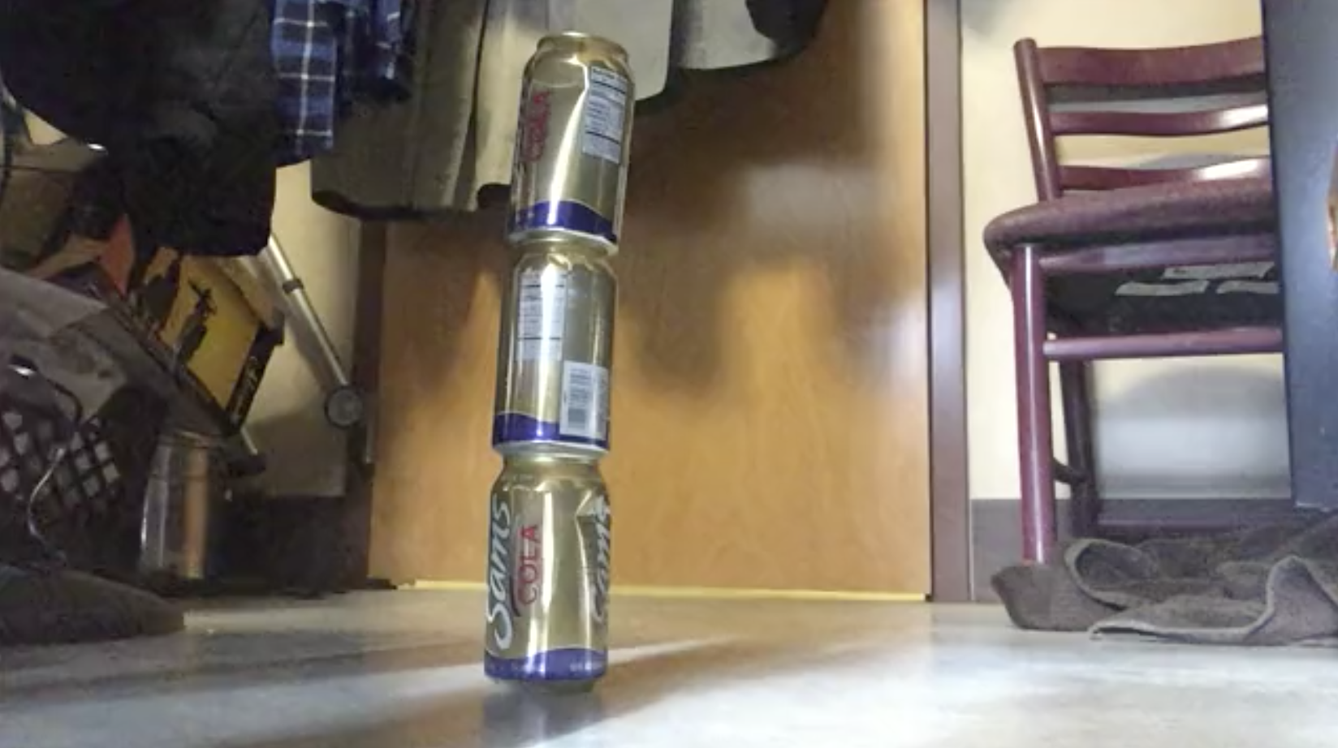
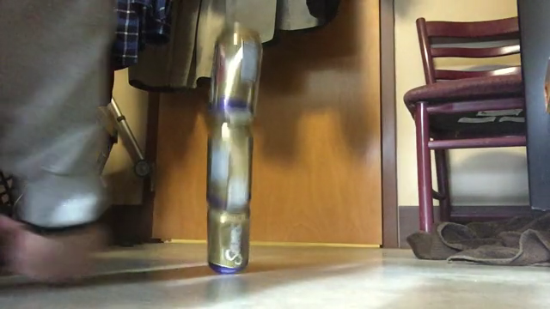
Problem Statement
What action leads to this outcome?
?

Slide 3
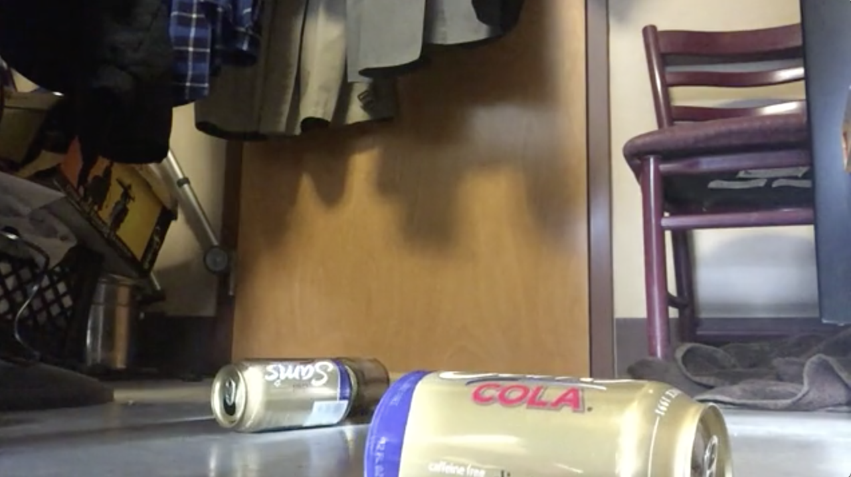
Problem Statement
Observation-Action-Effect framework for video event analysis
We aim to describe the action that happened in the video, in the form of natural language
The action verbs are result verbs, or in particularly, verbs lead to change of object state
Observation
Action
Effect
Poking a stack of cans so the stack collapses
Example from Something-Something dataset
Notes:
We study action causality and how object changes

Slide 4
Related Work
Gao et al. (ACL 2016) – Model the physical causality of action verbs and ground verb arguments in videos
Alayrac et al. (ICCV 2017) – Jointly discover action verbs and object states in videos
Gao et al. (ACL 2018) – Given an effect (image), predict the action (label)
We study the action recognition problem from a unique perspective – description generation
where we ground action arguments, i.e., objects, to better recognize the action

Slide 5
Dataset
Something-Something v2
Action templates
e.g., “Putting [something] onto [something]”, “Squeezing [something]”
Action arguments and video descriptions
“Putting [a cup] onto [a table]”, “Squeezing [paper]”
Stats
221k video clips (train: 169k, val: 25k, test: 27k)
174 action labels
319k video descriptions
Also YouCook2
Mahdisoltani et al., On the effectiveness of task granularity for transfer learning, ArXiv 2018.
Notes:
Sth-sth v2 is ideal for our problem!

Slide 6
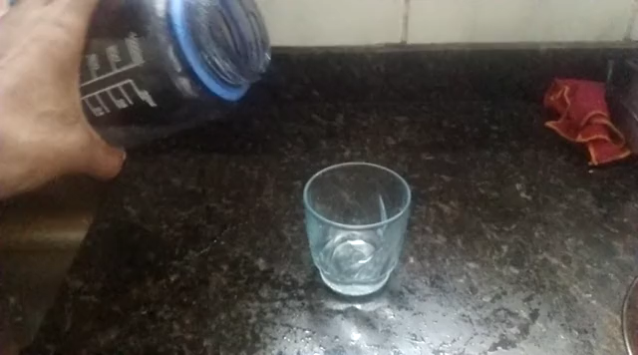
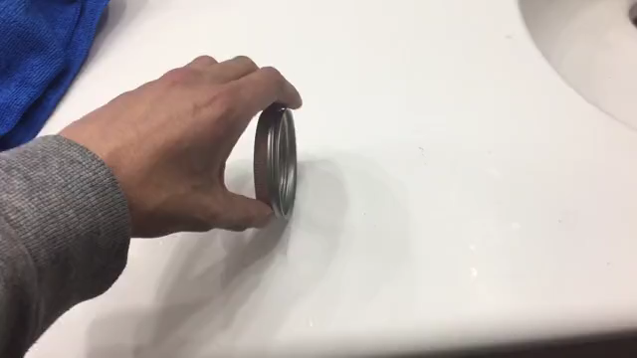
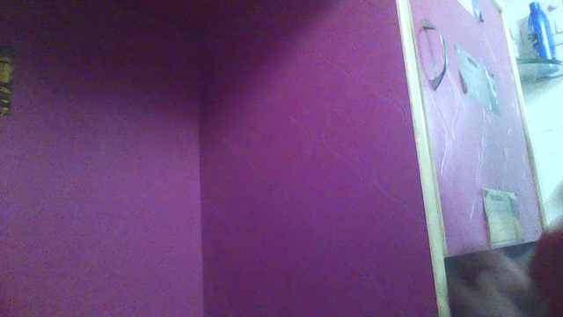
Dataset
Visual examples (red: actions; green: objects)
Trying to pour [water] into [a glass], but missing so it spills next to it
Spinning [a bracelet] so it continues spinning
Pulling two ends of [a rubber band] so that it gets stretched

Slide 7
Method
Baseline – Grounded Video Description
Proposed method – Video Description with Action-Conditioned Object Grounding
Might as well explicitly model action causality as the knowledge aid

Slide 8
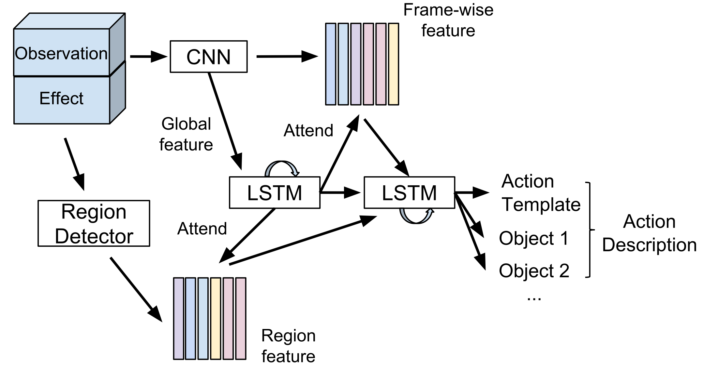
Method - Baseline

Slide 9
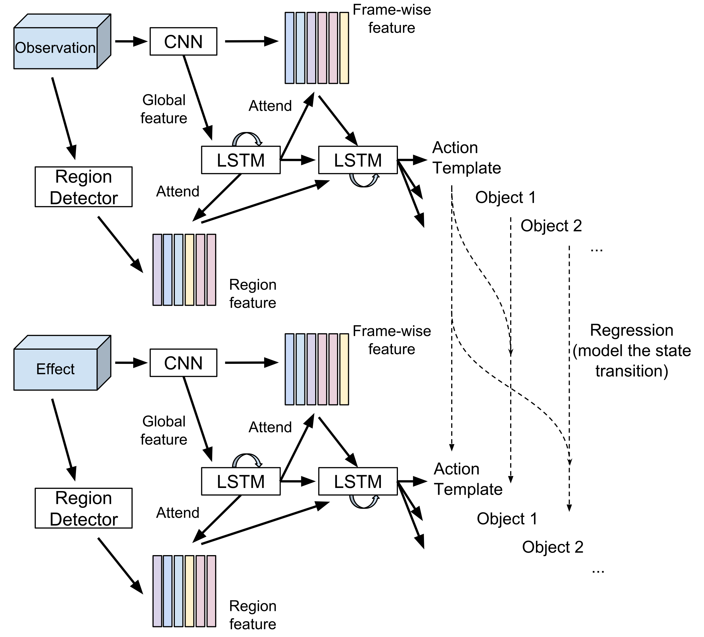
Method - Proposed

Slide 10
Challenges
How to divide a video into evidence and effect?
How to explicitly model the (action-conditioned) object state transition?
Weakly-supervised object grounding
Notes:
Weakly-supervised object grounding with high accuracy is still hard.

Slide 11
Evaluation – Compared Methods
Captioning
CVPR 2019 submission on grounded video description
CVPR 2018 on masked transformer
Action recognition (TBD)
CVPR 2019 submission on dynamic graph modules for action recognition
Something-Something Leaderboard (https://20bn.com/datasets/something-something)

